Slide 1
AVL Trees
Balancing

Slide 2
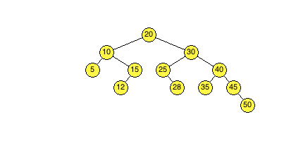
The AVL Tree
An AVL tree is a balanced binary search tree. What does it mean for a tree to be balanced? It means that for every node in the tree, the height of its children differs by no more than 1. The white number below each node represents the height of that node in the tree. The tree below is currently balanced.
The height is computed in the following manner:
A NULL child has a height of -1
A leaf node has a height of 0
The height of each node is equal to the maximum of the
heights of its children plus 1
4
2
3
0
1
1
2
0
0
0
1
0

Slide 3
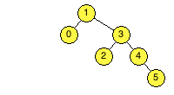
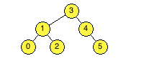
Correcting Imbalances
Adding to and removing from an AVL tree can create imbalances between nodes. Correcting these imbalances is what makes an AVL tree more efficient. These corrections are often called rotations in that they appear to rotate a parent downward and a child upward.
In the example below, node 1 is unbalanced. By “rotating” nodes 1 and 3 counter-clockwise, or by bringing node 1 downward and node 3 upward, the tree becomes balanced in all nodes.
Before rebalancing
After rebalancing
3
2
0
2
1
1
0
1
0
0
0
0

Slide 4





Unbalanced Trees
Adding to and removing from an AVL tree can result in four kinds of unbalanced trees. You can determine the kind of rebalancing you must use by following along the path of the heavier child.
Consider the first case. Node 0’s two children have heights -1 and 1, so we move right to node 1 (height 1). Node 1’s children have heights -1 and 0, so we move right to node 2 (height 0), giving us a right – right imbalance.
Right – Right
Left – Left
Each of the four imbalances will rebalance to the tree
2
2
1
1
0
0
Right – Left
Left – Right
1
2
2
0
0
1
1
0
0

Slide 5
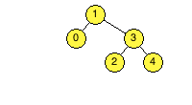
Right – Right Imbalance
In the example below, node 5 has been added to the tree. This results in a Right – Right imbalance in node 1 (its children have heights 0 and 2, which differ by more than 1; its right child, 3, is heavier on the right).
Note that the only connections that change are highlighted in red. Also note that node 3 is the new root of the subtree.
A Right – Right imbalance and a Left – Left imbalance are resolved in a similar manner.
Before
After adding 5
After rebalancing
2
3
2
0
1
0
2
1
1
0
0
0
1
0
0
0
0

Slide 6
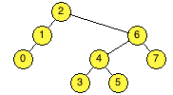
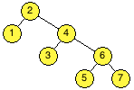
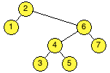
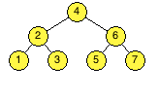
Right – Left Imbalance
A Right – Left imbalance is resolved in two rebalancings. The first rebalance shifts the tree into a Right – Right imbalance, and the second rebalance resolves the Right – Right imbalance as demonstrated before.
In the example below, node 0 is removed from the tree. The first rebalance is shown in green lines; the second rebalance is shown in blue lines.
Before
Rebalance 1
3
3
1
2
0
2
0
1
0
0
1
0
0
0
0
After removing 0
Rebalance 2
3
2
0
2
1
1
1
0
0
0
0
0
0
0

Slide 7
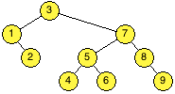
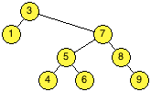
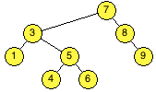
Default to Right – Right
In some instances, removing a node can result in an imbalance that could be resolved using either Right – Right or Right – Left rebalancing. In this case, you should default to Right – Right.
In the example below, node 3 is not balanced after removing node 2. Since node 7’s children both have a height of 1, neither node is heavier than the other. Both Right – Right rebalancing and Right – Left rebalancing are valid options, but the test driver will only accept a Right – Right rebalance.
Note that Left – Left rebalance should be used over Left – Right rebalance.
Before
After removing 2
After rebalancing
3
3
3
1
2
0
2
2
1
0
1
1
1
1
0
1
0
0
0
0
0
0
0
0
0

Slide 8
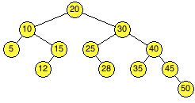
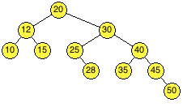
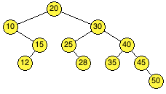
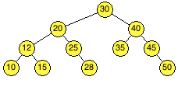
Multiple Imbalances
Sometimes, solving an imbalance can result in another imbalance further up the tree. In the example below, node 10 is no longer balanced after removing node 5. After rebalancing node 10, node 20 is unbalanced. Thus, it is important to check for imbalances all the way back to the root after each add and remove.
Before
After balancing 10
4
4
2
3
1
3
0
1
1
2
0
0
1
2
0
0
0
1
0
0
1
After removing 5
0
After balancing 20
0
4
3
2
3
2
2
1
1
2
1
1
0
1
0
0
0
1
0
0
0
0
0

